Slide 1
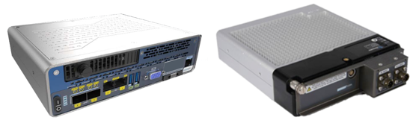

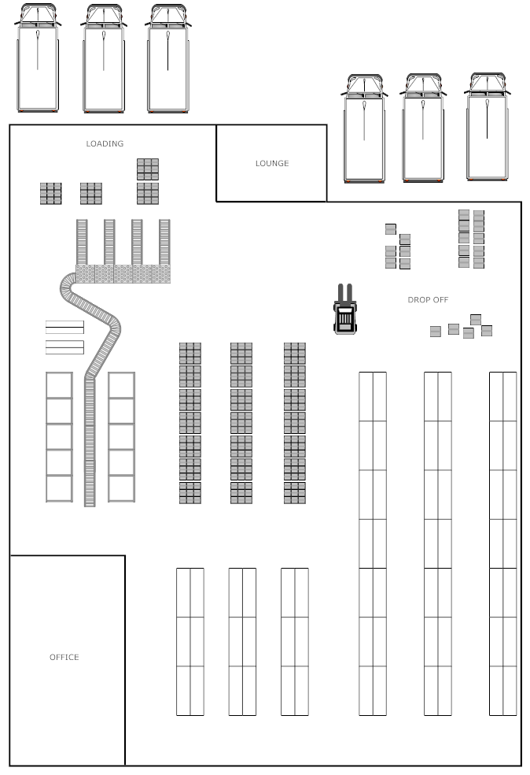
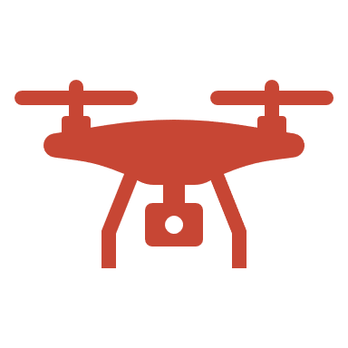
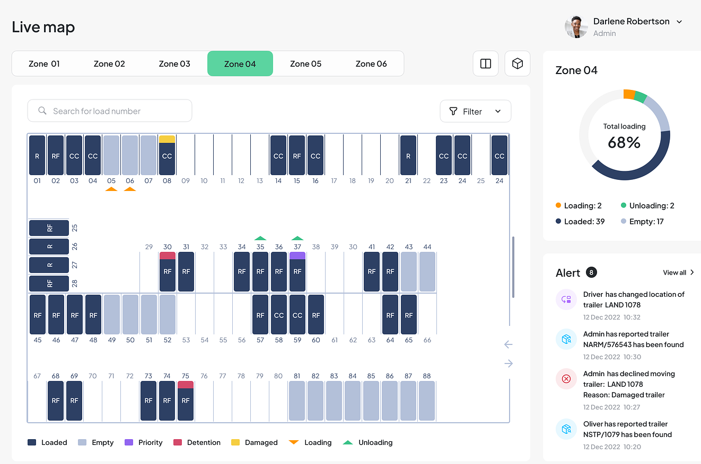


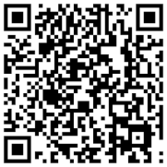
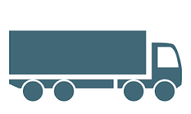

Digital Container and Trailer Yard Track and Trace
Skydio Drone Manager
Autonomous Yard Mule
Roving Edge
Web API
Document Ingestion
QR Code on App
Driver Check-In
Roving Edge
Yard Live Tracking
Warehouse
Notes:
Learning Labs:
https://apexapps.oracle.com/pls/apex/r/dbpm/livelabs/run-workshop?p210_wid=3426&p210_wec=3560-PGGN-XFWQ-QWXO&session=14791622785887

Slide 2
Features and Components
# | Feature
1 | Skydio Drone to identify “Drop” or “Live Load” from Driver check-in
2 | Drone to take pictures and guide trailer to yard location (for drop) or warehouse dock door (live load)
3 | Electronic inbound gate management with AI document recognition and drone assistance
4 | Drone to beam back coordinates for central yard optimization system
5 | Drone to detect anomaly – trailer was not due for loading or move, seal-tampering, theft
6 | Electronic outbound gate management – AI document understanding and drone identify trailer number
7 | Live Map with feeds to Yard Management, Warehouse Management and Order Management systems using AI Vision and Oracle Streaming
8 | Oracle Roving Edge to ensure connectivity and local processing
9 | Scan bar codes, RFID tags, QR codes at various steps for verification with AI Vision
10 | Feed communication systems – transmit data to drivers, carriers, shippers, etc.
11 | Track all assets, trailers, tractors, yard tractors, operators, safety equipment with AI Vision
12 | Track overflow inventory stocked in temporary trailers or locations with AI Vision
13 | Integration and process orchestration with Oracle Integration Cloud

